Slide 1
REAL TIME STRESS DETECTION AND PROPOSED SOLUTION
BY – NANCY PARETA
SID-19205004
MTECH(CSE)

Slide 2
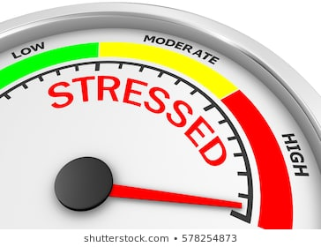
PURPOSE OF STUDY
Increasing academic pressure.
In-ability of an individual of expressing problems and taboo associated with mental health issues.
Survey conducted by Cigna TTK Health Insurance:
OUTCOMES OF SURVEY
89% of the population in India suffering from Stress.
75% answerers find it uncomfortable to share their stressful thoughts.
https://economictimes.indiatimes.com/magazines/panache/89-per-cent-of-indias-population-suffering-from-stress-most-dont-feel-comfortable-talking-to-medical-professionals/articleshow/64926633.cms

Slide 3

PURPOSE OF STUDY
Increased suicidal rates among age group 14-30.
STRESS RESULTS TO:
Mental illness, irritation
Health disorders, anxiety issues
Depression, isolation from society
Unhealthy lifestyle, silent heart attacks, and various other medical conditions.

Slide 4
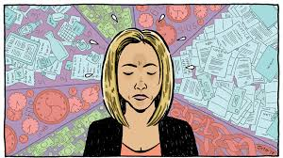
INTRODUCTION
Human psychological stress and human emotions are very much interconnected.
In computational psychology study, the relationship between stress and emotions is the key to understanding the human behavior.

Slide 5

PROBLEM STATEMENT
Existing Stress detection techniques are mainly face-to-face interviews, self-file mental questionnaires and physiological sensors.
These methods are commonly exertions-ingesting, time-costing and hysteretic.
The knowledge of Psychological Stress and Human Emotions is well related but has not been explicitly taken up for research yet.

Slide 6
OBJECTIVES
To develop a stress monitoring system that will indicate the stress levels in real time without asking the subject, answers to questions, biological samples all the time as this would help not to intervene in a person’s day to day schedule.
To investigate the relationship between Human emotion and Stress .

Slide 7
LITERATURE SURVEY
TITLE | YEAR | AUTHORS | KEY FINDINGS
A Facial Expression Recognition System Using Convolutional Networks. | 2015 | Andre Teixeira Lopes, Edilson de Aguiar, Thiago Oliveira-Santos | CNN implementation to extract expression specific features of a face image .
Real-time Convolutional Neural Networks for Emotion and Gender Classification. | 2017 | Octavio Arriaga Paul G. Plöger Matias Valdenegro | A real-time vision system which accomplishes the tasks of face detection, gender classification and emotion classification.
Going deeper in facial expression recognition using deep neural networks. | 2016 | D. C. Ali Mollahosseini and M. H. Mahoor | Address the FER problem across multiple well-known standard face datasets.

Slide 8
LITERATURE SURVEY
TITLE | YEAR | AUTHORS | KEY FINDINGS
Stress and anxiety detection using facial cues from videos | 2016 | G. Giannakakisa, M.Pediaditisa, D.Manousosa, E.Kazantzakia | Focused mainly on non-voluntary and semi-voluntary facial cues in order to estimate the emotion representation more objectively
Objective measures, sensors and computational techniques for stress recognition and classification | 2012 | N. Sharma, T. Gedeon | Model stress based on techniques such as Bayesian networks, artificial neural networks, and support vector machines.
Recognition of Stress levels among students with wearable sensors | 2019 | Amir Hasanbasic, Mustafa Spahic | Features of Electrocardiogram and EDA for different classification

Slide 9
MODELS OF STRESS DETECTION MODEL 1: Stress detection model Image Emotion Classification
A CNN is trained to detect and recognize facial expressions and classify human faces into discrete emotion categories (Anger, Disgust, Neutral, Fear, Sad, Happy and Surprise).
PROPOSED METHODOLOGY
Our model comprises of two main steps:
Facial emotion recognition
Stress detection from the deciphered emotions

Slide 10
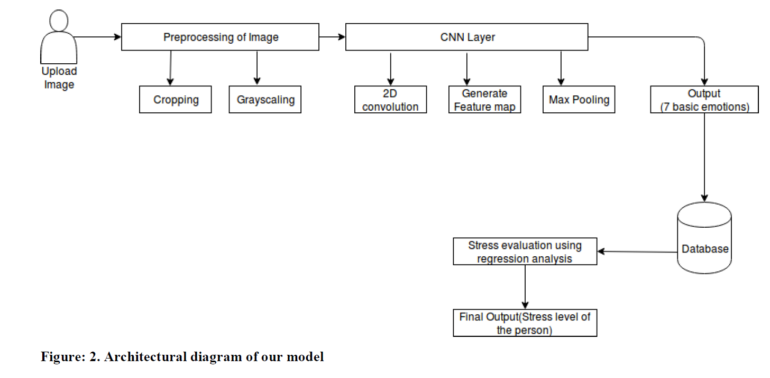

Slide 11
DATASET
We have used FER2013 dataset from the Kaggle Facial Expression Recognition Challenge to train our model.
The dataset consists of 35,887 grayscale images, each image of 48-by-48 pixel labelled with one of the 7 emotion categories: Angry, Disgust, Fear, Happy, Sad, Surprise and Neutral.
We used 80% of the dataset for training and remaining 20% for testing.

Slide 12
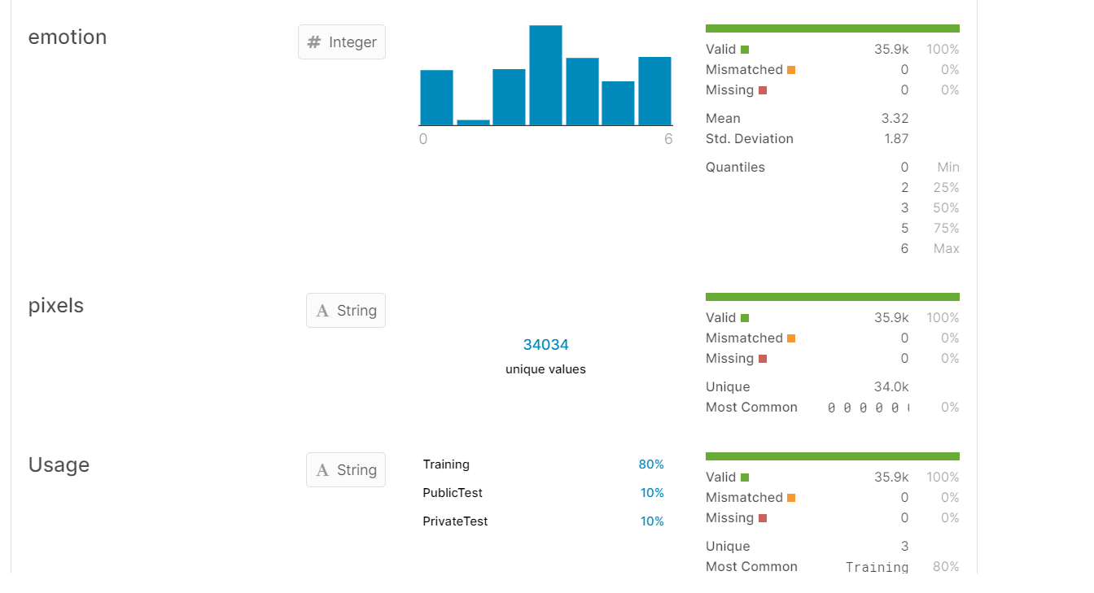

Slide 13
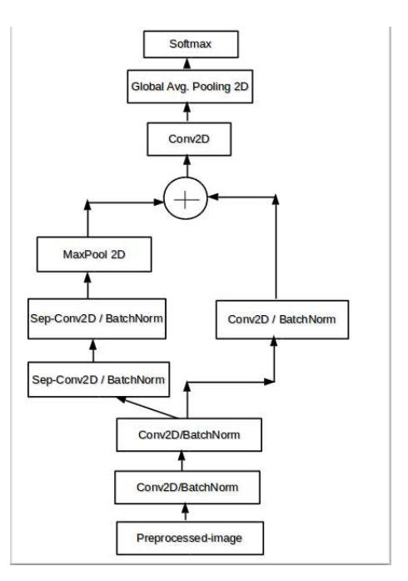
STEP 1 CNN IMPLEMENTATION

Slide 14
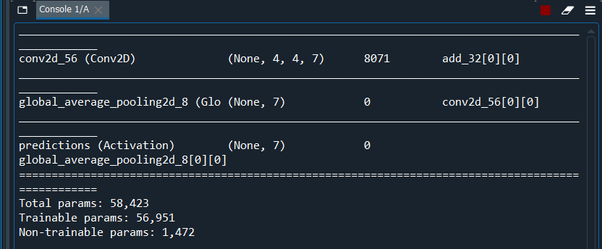
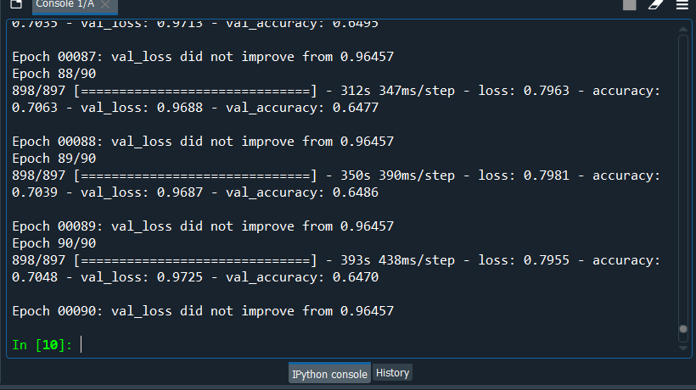

Slide 15
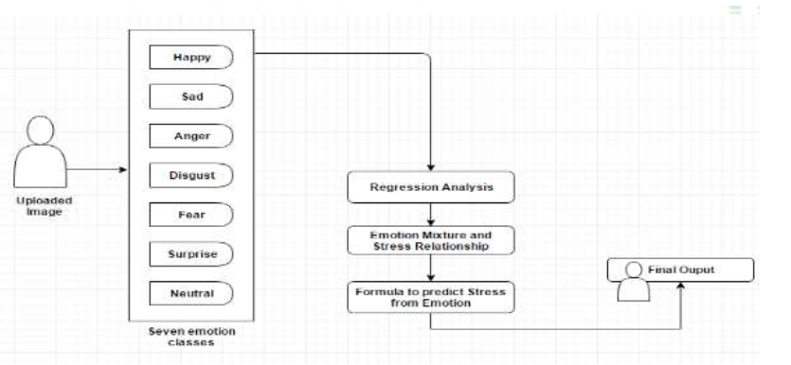
STEP 2 EVALUATION OF STRESS LEVELS

Slide 16
RESULTS
Results of the emotion classification task and stress level detection can be observed in the next slide.
The corresponding image and its detected emotion label and probability and stress probability is shown in these images.

Slide 17
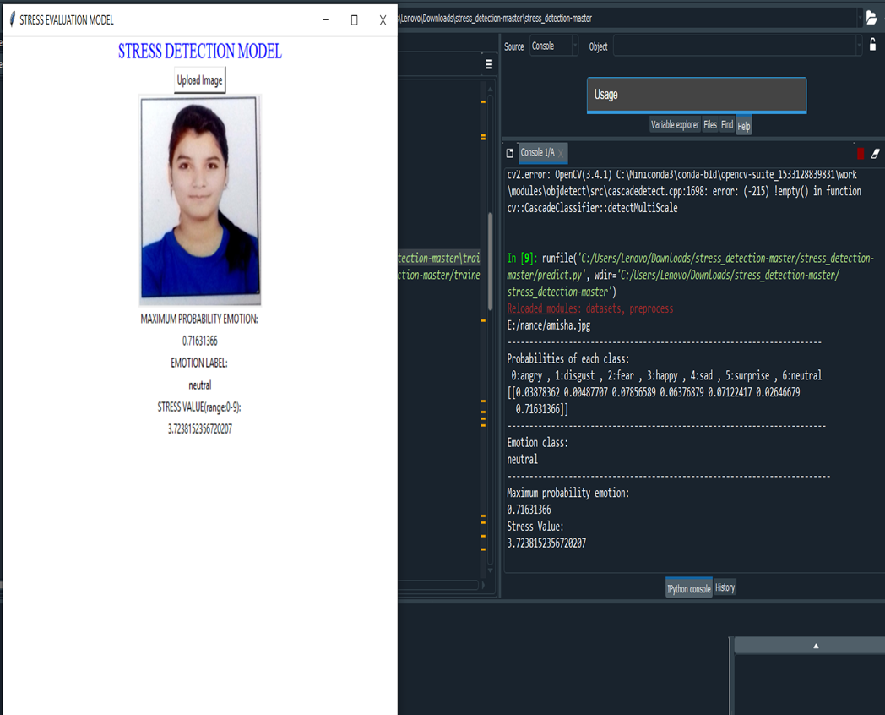

Slide 18
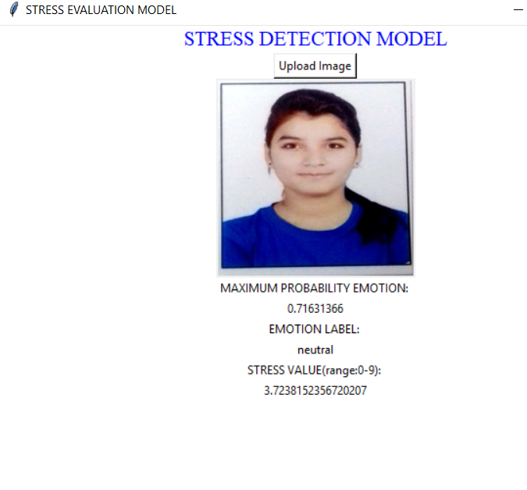
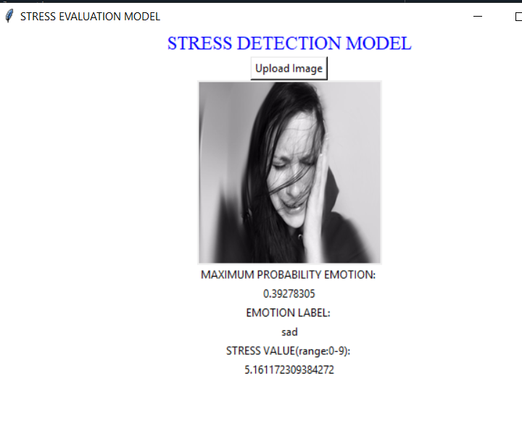

Slide 19
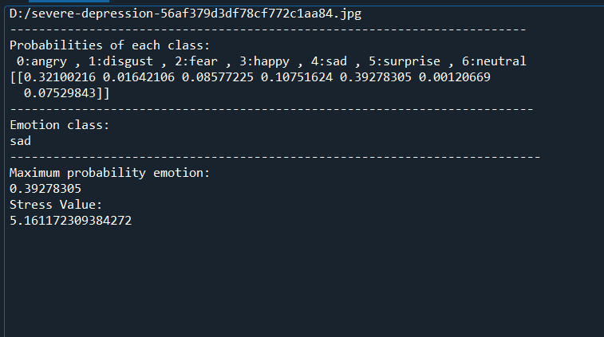

Slide 20
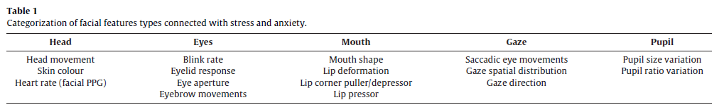
MODEL 2: Real time face stress detection model

Slide 21
EYE BLINKING
Blinking can be voluntary but also as a reﬂex to external or internal stimuli and The blinking rate typically increases with emotional arousal, including stress and anxiety levels .
The blinking rate is affected by various other states, such as lying , and disorders such as depression, Parkinson’s disease and schizophrenia .

Slide 22
EYEBROW MOVEMENTS
The stress level is calculated with the help of eyebrows contraction and displacement from the mean position.
The distance between the left and right eyebrow is being calculated and then the stress level is calculated using exponential function and normalized between 1 to 100.

Slide 23
FACIAL EMOTION DETECTION (REAL TIME VIDEO ANALYSIS)
Darwin argued that facial expressions are universal, i.e. most emotions are expressed in the same way on the human face regardless of race or culture .
Our project implementation report ﬁndings that facial signs and expressions can provide insights into the analysis and classiﬁcation of stress.

Slide 24
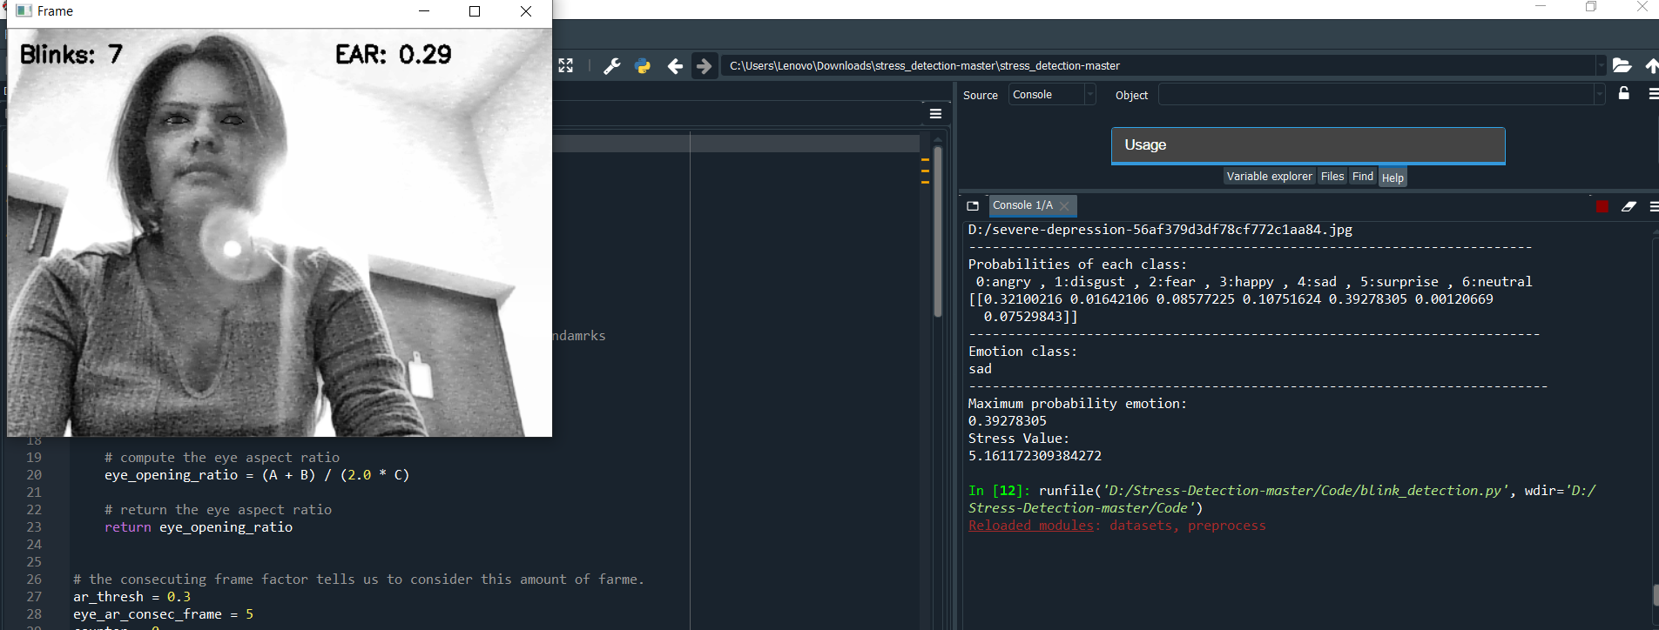
RESULTS EYE BLINKING

Slide 25
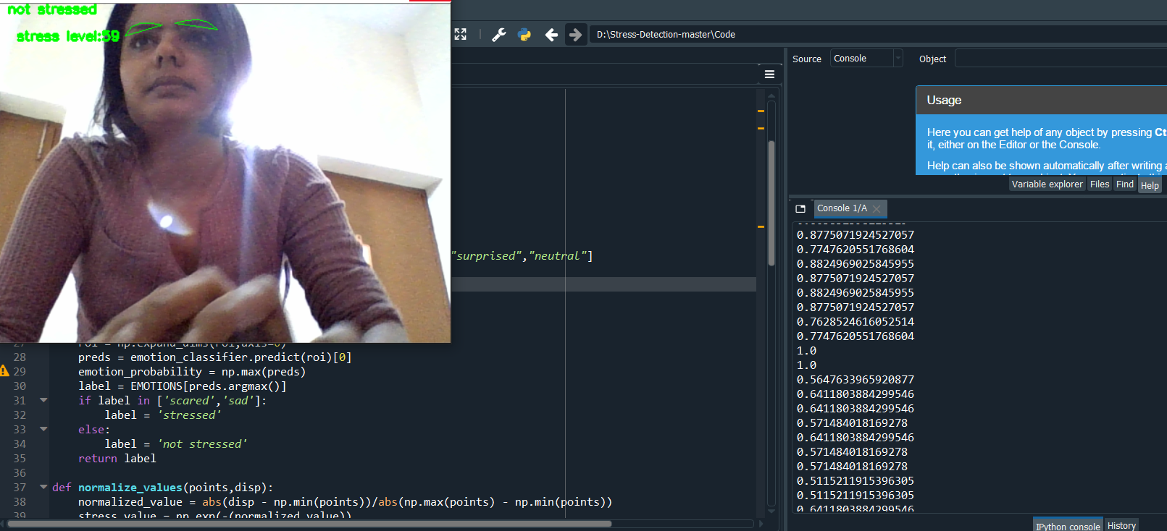
RESULTS EYEBROW MOVEMENTS

Slide 26
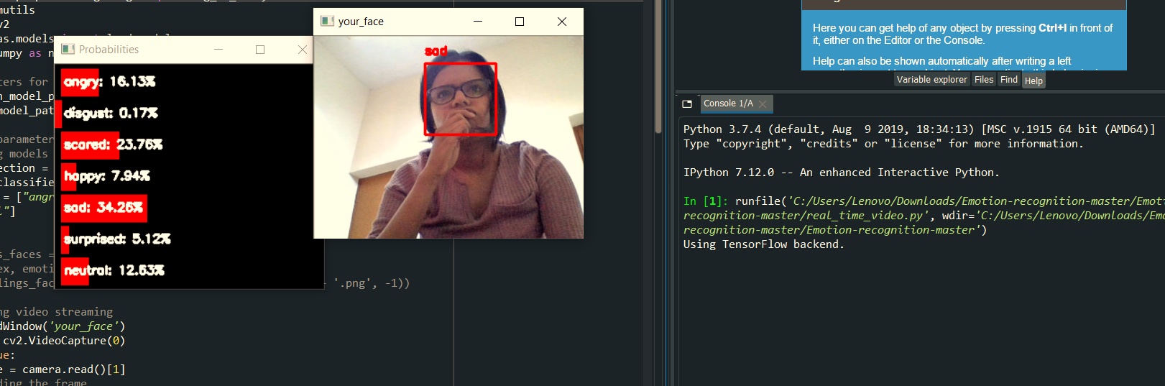
RESULTS FACIAL EMOTION DETECTION (REAL TIME VIDEO ANALYSIS)

Slide 27
IMPLICATIONS AND LIMITATIONS
We are aware that our current implementation of the stress detection model may have the following limitations.
If anyone tries to give fake expressions or if there is beard or glasses are used in the image, our model may give wrong output.
Also, as the training done on the images is less, the expressions like fear, sad or disgust may not be correctly identified.

Slide 28
CONCLUSION
Various techniques of stress detection is discussed. The first module is further divided into:
Capturing face data to predict stress scores.
This project presented a novel solution, for stress detection from facial emotion recognition using CNN. As shown in the results, in comparison with the other methods that use the same facial expression database, our method uses CNN that works better for images, and presents a simpler solution.
Real time video analysis for counting number of blinks ,eyebrow movements and detecting emotions to which predefined classes it belongs to.
The motive for this part is to analyze how accurate the predictions are solely based on captured face data. Try to be clear with your emotion, Fakeness cannot be detected. The model is moderately accurate because the data could not be arranged within stipulated time.

Slide 29

FUTURE WORK
The model can be improved by including other facial features inputs as well. The feature include:
Lip movement, Head positioning, Gaze movement
The above features can be detected and a cumulative function can be defined to give out the total stress value.
GALVANIC SKIN RESPONSE SENSOR

Slide 30
REFERENCES
[1] Andre Teixeira Lopes, Edilson de Aguiar, Thiago Oliveira-Santos, A Facial Expression Recognition
System Using Convolutional Networks.
[2] Arushi Raghuvanshi, Vivek Choksi, Facial Expression Recognition with Convolutional Neural
Networks.
[3] Shima Alizadeh, Azar Fazel, Convolutional Neural Networks for Facial Expression Recognition.
[4] Haoxiang Li, Zhe Lin ,Xiaohui Shen ,Jonathan Brandt, Gang Hua, A Convolutional Neural Network
Cascade for Face Detection.
[5] S. Z. Li and A. K. Jain, Handbook of Face Recognition. Springer Science & Business Media, 2011.
[6] C.-D. Caleanu, “Face expression recognition: A brief overview of the last decade,” in 2013 IEEE 8th
International Symposium on Applied Computational Intelligence and Informatics (SACI), 2013, pp.157–161.
[7]www.kaggle.com/c/challenges-inrepresentation-learning-facial-expressionrecognitionchallenge/data

Slide 31
REFERENCES
[8] Stress andanxiety detection using facial cues fromvideos G. Giannakakisa, M.Pediaditisa, D.Manousosa, E.Kazantzakia, F.Chiarugia, P.G. Simosb,a, K.Mariasa, M.Tsiknakisa
[9] ET Bureau, “89 per cent of India’s population suffering from stress; most don’t feel comfortable talking to medical professionals.”
[10] M. Sysoev, A. Kos, U. Sedlar, and M. Pogacnik, “Sensors classification for stress analysis: Toward automatic stress recognition,” Proc. - 2014 Int. Conf. Identification, Inf. Knowl. Internet Things, IIKI 2014, pp. 117–121, 2014.
[11] The University of St Andrews, “A Guide to Employee Stress Recognition.”
[12] A. Hasanbasic, M. Spahic, D. Bosnjic, H. H. Adzic, V. Mesic, and O. Jahic, “Recognition of stress levels among students with wearable sensors,” 2019 18th Int. Symp. INFOTEH-JAHORINA, INFOTEH 2019 - Proc., no. March, pp. 20–22, 2019.

